Slide 1
Parameter Estimation in Finite Element Simulations of Rayleigh Waves
BY:-Jubin kumar soni

Slide 2
objective
Spectral analysis of surface waves(SASW) measurements are used to develop subsurface soil profiles. Finite element modelling of Rayleigh waves has practical application in simulating SASW measurements.
Developing a reliable and accurate finite element model to simulate Rayleigh waves requires the proper mesh dimensions and attenuation parameters.
This research paper proposes a new simplified methodology for quantifying mesh dispersion effects and methods of verifying damping ratios for numerical simulations.

Slide 3
Introduction
The spectral analysis of surface waves (SASW) technique is based on the analysis of vibrations created by Rayleigh waves that propagate along the surface of a medium
Velocity dispersion of Rayleigh waves is used to provide near-surface soil profiles
The Newmark-beta method is a useful and versatile finite element tool for modeling Rayleigh wave propagation. A finite element model applied to this application requires mesh parameters and constants representing material behavior.

Slide 4
The mesh design and selection of appropriate model parameters to obtain accurate results is time-consuming. One method of developing a finite element simulation is to select the model parameters and quantify the accuracy of the results. The user may then decide to carry forward with the developed model or do some changes before using it

Slide 5
The accuracy and stability of finite element models are primarily affected by the spatial-temporal discretizations within the mesh. To minimize the effects of mesh filtering, the maximum mesh size is calibrated to the wavelength of the slowest propagating wave. In the temporal domain, improper discretization can cause instability
It is found that propagation velocity decreases for smaller mesh sizes and that it increases for smaller time increments

Slide 6
Another important factor influencing the numerical accuracy of finite element simulations is the treatment of damping. Two types of attenuation are encountered in finite element models: numerical and material attenuation.
The Newmark-beta integration parameters cause numerical attenuation, whereas Rayleigh damping parameters provide linear material attenuation.

Slide 7
The purpose of this study is to introduce an innovative method to quantitatively evaluate mesh limitations and damping effects of a finite element model applied to simulating transient wave propagation.
The reliability of these techniques is assessed using the analytical solution of Lamb’s problem for the vertical time history of a Rayleigh wave

Slide 8

Spatial-Temporal Discretization
In wave propagation problems, element dimensions are chosen with respect to the highest frequency (f max) for the lowest velocity wave (VR).
Element dimensions that are too large will filter high frequencies, whereas very small element dimensions can introduce numerical instability. An approximate element dimension (g) is calculated using

Slide 9



The time increment must be carefully chosen to maintain numerical stability and accuracy. The calculation of the time increment depends on the element dimension computed with the following expression:

Slide 10
Damping Attenuation or damping has various quantitative expressions depending on application. Two types of attenuation can be distinguished in finite element modelling: numerical and material attenuation.
Numerical attenuation is caused by the Newmark-beta parameters controlling the time integration scheme. Numerical damping is also caused by the mesh, which removes wavelengths shorter than the Nyquist limit.
The material damping is user-defined and controls the energy dissipation per cycle.

Slide 11

In dynamic finite element analysis, the governing equation of motion is expressed as:
W is circular frequency due to applied force or forcing frequency
damping matrix could be expressed as a linear combination of the mass and stiffness matrices. This type of damping is referred to as Rayleigh damping

Slide 12
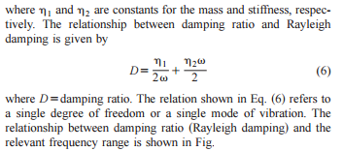

Slide 13
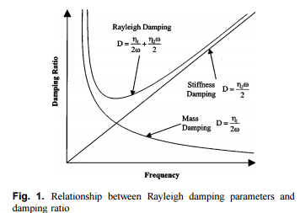


Slide 14

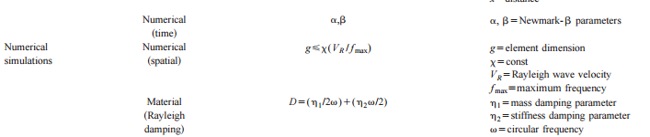

Slide 15
Analysis method
Two main issues in finite element simulations of wave propagation: the optimum element size and the evaluation of the actual damping in the model.
A frequency–wave-number analysis applied to vertical nodal displacements will highlight dispersion effects caused by the mesh.
Damping generated by the finite element model is examined with power spectral ratios. Both methods are tested using the analytical solution to Lamb’s problem for the vertical displacement of a Rayleigh wave.

Slide 16

Lamb’s Problem
Lamb calculated the far-field vertical and horizontal displacement histories generated by a point source on an infinite half-space.
Loading is simulated using a point source acting on the surface of an infinite half-space given by

Slide 17
Array Signal Processing
Numerical dispersion of different wave types can be computed using array measurements.
Vertical nodal displacements calculated at equidistant surface nodes define a receiver array.
Displacement time histories are assembled into a matrix where each column represents amplitude in time and each row defines amplitude in space.
Peaks in the contour plot correspond to the various wave types, and their trends are used to measure the dispersive properties of the finite element mesh.

Slide 18
Damping Calculations
Spectral amplitudes of a plane wave can be represented by
where A=amplitude; f = frequency; Ge is a term that includes geometrical spreading and reflections; x=distance from source; and a(f ) =attenuation coefficient.alpha,beta=newmark parameter.
If measurements are made at two separate locations, the ratio of amplitudes can be expressed as:

Slide 19


The subindex denotes the receiver number can be rewritten as
The first term on the left-hand side of represents the power spectrum ratio and the second term accounts for geometric damping. Material attenuation is considered on the right-hand side of equation.

Slide 20

Eqation can be used to define a measure of absolute damping or relative damping. Absolute damping refers to measurements made at different locations on the same finite element model. In terms of damping ratio (D), absolute damping is defined as

Slide 21

where VR=Rayleigh wave velocity and deltax=distance between the two measurements. Relative damping compares the attenuation at the same location (i.e.,x1=x2)for two different finite element models. In this case, both models are identical except for the Rayleigh damping parameters. Relative damping (DD) is de- fined as the difference in attenuation between two different materials

Slide 22
where x is the distance from the source. Absolute damping is calculated for subsequent finite element simulations to compare damping generated by a finite element model to attenuation measured in a field or laboratory setting. Relative damping is compared with absolute damping to examine the effectiveness of the Rayleigh damping model.

Slide 23
Finite Element Simulations
The array and damping measurement techniques are applied to a series of finite element models.
Rayleigh wave dispersion is examined using two mesh designs. One mesh is composed of rectangular elements each having identical dimensions. The second mesh is graded in the vertical direction, with smaller elements near the surface where the Rayleigh wave is propagating. Both mesh designs have the same number of elements and are surrounded on three sides by nonreflecting elements to represent an infinite half-space.
The Newmark-beta and Rayleigh damping parameters are altered similarly for uniform and graded mesh designs to examine the effect of numerical attenuation on the damping measurements.

Slide 24
Model Parameters
Input parameters for the finite element model are chosen to simulate a series of laboratory experiments completed on a box filled with dry sand.
The body and Rayleigh wave velocities in the dry sand are VP=170 m/s (compression), VS=60 m/s (shear), and VR=56 m/s (Rayleigh). The bulk density is computed as rho= 1,656 kg/m3 , assuming a void ratio of e=0.6 and a specific gravity of G=2.65. Young’s modulus and the shear modulus are calculated using the wave velocities and the computed Poisson ratio of n=0.43.
Young’s modulus is calculated as E=16.8 MPa and the shear modulus is G=5.88 GPa.

Slide 25
The uniform mesh is designed by first calculating the maximum mesh dimension.The maximum dimension depends on the Rayleigh wave velocity, the highest propagating frequency, and the constant x.
Laboratory measurements show the frequency bandwidth to be between 0.2 and 1 kHz (lambdamin=56 mm). The value of x is 0.25 which gives a maximum dimension of 14 mm.
Therefore, elements are 10 mm in the horizontal direction and 14 mm in the vertical direction, giving 3,196 elements within the solution domain. Smaller elements are near the surface, whereas larger elements are located at the bottom of the mesh. Elements used have bilinear interpolation functions.

Slide 26

The time increment is computed by following equation .
With a maximum element dimension of 14 mm, the largest time increment is 8.2X10^-5 s and the smallest time increment is 8.2X10^-6 s. The time increment used in these simulations is 1X10^-5 s (Nyquist frequency=50 kHz)

Slide 27

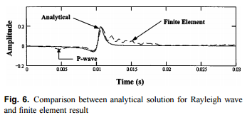
The loading function used to generate the Rayleigh wave is calculated with Equation:
Fb=2X10^-6 ,psi=6.Comparison of time-domain traces in Fig. 6 shows a good agreement between the solution to Lamb’s problem and the finite element results.

